Slide 1

For LOOPs
An Introduction to Programming in Python
Notes:
Let's learn about For Loops.

Slide 2
Doing Things Multiple Times
costs = [100, 25, 25, 50, 10]
print(costs[0])
print(costs[1])
print(costs[2])
print(costs[3])
print(costs[4])
for a_cost in costs:
print(a_cost)
Notes:
Observe the code below, which prints out the following 5 numbers.
We had to write a print statement 5 times, once for each number.
Surely there's a way that will let us stop writing the same chunk of code each time?
For Loops are an amazingly useful tool that let us perform an action on each element of a list.

Slide 3
Syntax
Iteration variable
In keyword
List variable
For keyword
Colon
for item in a_list:
pass
Body
Indentation
Notes:
Here's how we write a For loop.
First, we write the word 'for'.
Then we make a new variable named the iteration variable.
We'll come back to this later.
Next, we write the word 'in'.
Then, we put the list variable or value that we want to iterate over.
After that, we need to put a colon.
Finally, we put any statements to run inside the body of the loop.

Slide 4
The Iteration List
Each element in turn is assigned to the iteration variable
for item in a_list:
pass
10
10
20
1
1
Notes:
A crucial element of any For loop is the iteration list.
This is the data that we want to iterate over.
When the loop executes, each item of the list will be assigned to the iteration variable in turn.
It doesn't matter if the list has no items, ten items, or a thousand items; Python will still process each one in turn.

Slide 5
The Iteration Variable
for a_temperature in temperatures:
for a_book in books:
for a_name in names:
for a_fruit in fruits:
Notes:
One of the hardest things to understand about For loops is the iteration variable.
The iteration variable represents the generalized version of each item in the list.
If you have a list of temperatures, it is "a temperature".
If you have a list of books, it is "a book".
By performing operations on this generalized version of a list item, you can work on the entire list while only having to think about one element at a time.

Slide 6
The Body
for a_price in prices:
adjusted = a_price * .9
print(adjusted)
Notes:
Just like an If statement, we can put statements inside of a For loop.
Each statement is indented with four spaces, and each statement will be executed one-by-one, from top to bottom.

Slide 7
The Flow of a For Loop
for a_price in prices:
adjusted = a_price * .9
print(adjusted)
Notes:
Previously, we said that a program was like a river, running from the top to the bottom.
If statements made the stream split into two directions.
For loops also make the stream split, but one of the new streams will move back up.
This is the crucial idea, and its why we call it a loop.
The program will LOOP until each element of the list has been assigned to the iteration variable.

Slide 8
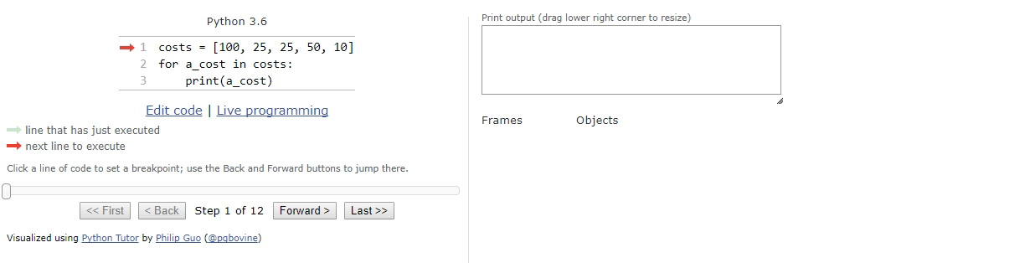
Tracing a For Loop
Notes:
Let's look at a loop in practice.
Notice how the value of the iteration variable changes each time we go through the loop again, and the cursor jumps back up to the start of the loop.
This behavior is crucial!
(You can view this yourself: https://goo.gl/yebYBw)

